Slide 1

Content Management System

Slide 2
What's a content management system (CMS)?
A content management system is software that keeps track of every piece of content on your Web site.
Content examples:
  simple text
  Photos
  Music
  Video
  Documents
A major advantage of using a CMS is that it requires almost no technical skill or knowledge to manage.
Notes:
Content Management systems can be used to both manage the material on a website and to create layouts for web pages.

Slide 3
What is Joomla?
Joomla is an award-winning content management system (CMS).
Create
  Applications
  Web Pages
  Forms
Open Source
Joomla is the most popular web site software available.
Notes:
Joomla evolved from the CMS known as Mambo. The development team of Joomla split from the Mambo project on August 17, 2005 to create Joomla which they believed would be a more capable CMS.

Slide 4
What’s it used for?
Joomla is used for all types of websites:
  Corporate Web sites or portals
  Corporate intranets and extranets
  Online magazines, newspapers, and publications
  E-commerce and online reservations
  Government applications
  Small business Web sites
  Non-profit and organizational Web sites
  Community-based portals
  School and church Web sites
  Personal or family homepages
Notes:
Because Joomla is open source, many corporations choose it as their CMS of choice. There are also many modular extensions available for Joomla which makes it adaptable to nearly any business.

Slide 5
Joomla Templates
Build your own template
Use one of Joomla’s pre-installed templates
Open source community templates

Slide 6
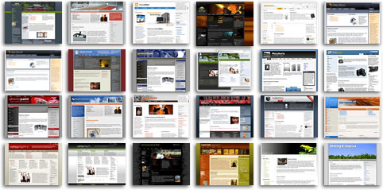
Joomla Templates

Slide 7
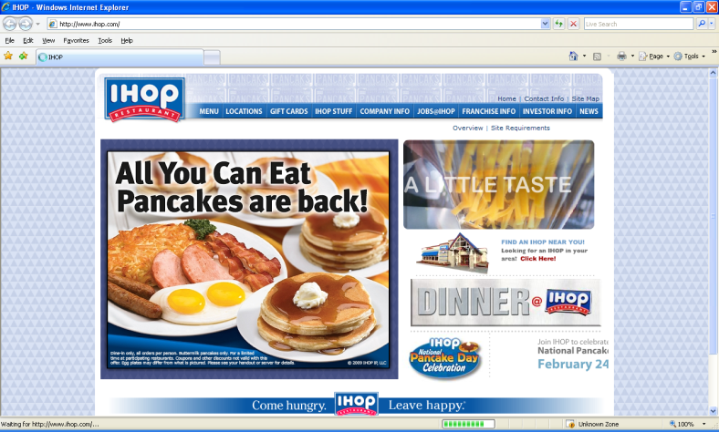
Examples
IHOP
  Menus
  Logos
  Email
  Newsletters

Slide 8
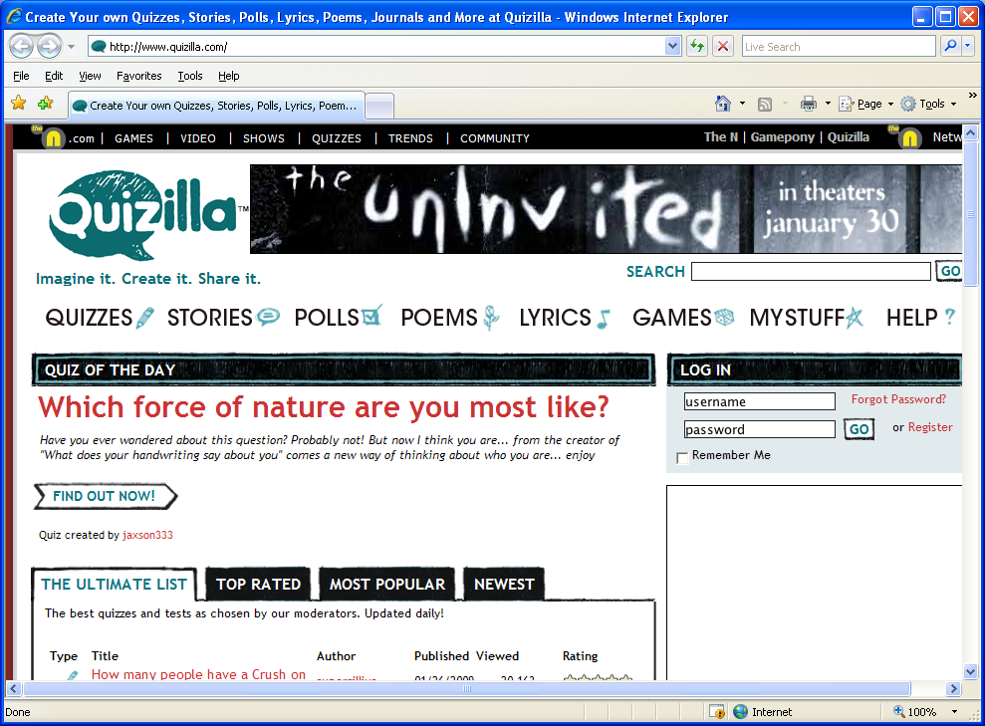
Examples
MTV Networks Quizilla (Social networking)
  Blogging
  Forums
  Pictures
  Applications
  PHP Login

Slide 9
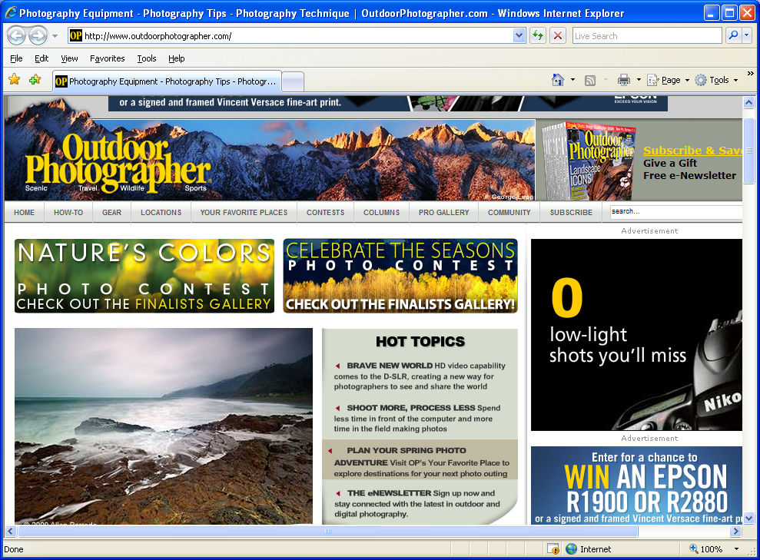
Examples
Outdoor Photographer (Magazine)
  Photos
  Photo Albums
  Photo Tagging
  Payments
  Forms

Slide 10
Joomla Features
Joomla supports
  Caching (for quicker load times)
  RSS feeds(Lectores de noticias)
  Printable versions of web pages
  News flashes
  Blogs
  Polls(creación de encuestas)
  Searches
  Language internationalization
Notes:
Joomla has the capability to run on Windows, OS X, and many distributions of Linux.
Joomla was designed to be used by people with little or no experience in HTML, XML, PHP, or SQL.

Slide 11
Joomla Requirements
Requirements to use Joomla
  Apache
  PHP
  MySQL
Packages
  XAMPP
  WAMP
Windows IIS Supported
Notes:
XAMPP and WAMPP are windows packages for installation of Apache, MySQL, and PHPAdmin. There are also similar packages available for OS X and various distributions of Linux.
Although Windows IIS can be used instead of Apache Web Server, the official Joomla site does not provide instructions on doing so. The instructions, however, can be found in many of the unofficial Joomla forums.

Slide 12

Advanced uses for Joomla
Further application development including:
  Inventory control systems
  Data reporting tools
  Application bridges
  Custom product catalogs
  Integrated e-commerce systems
  Reservation systems
  Communication tools
Notes:
Most of these applications can be developed with the plugins available for Joomla.

Slide 13
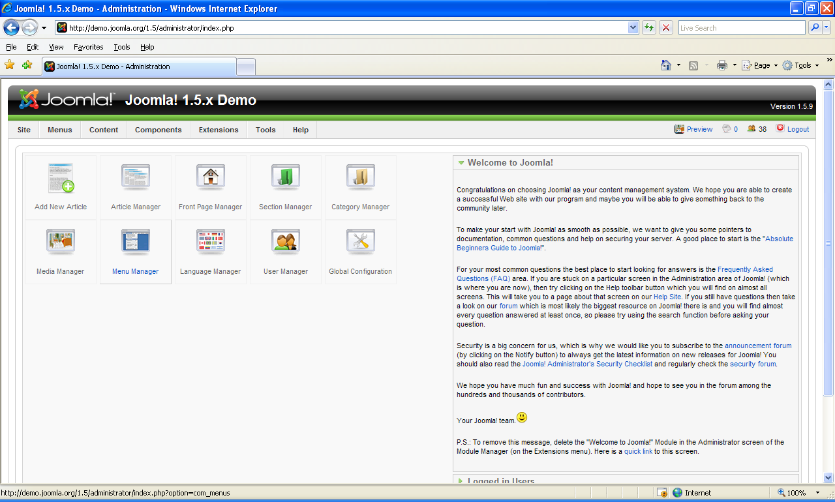
Joomla 1.5 Demo Web Site
Browse the public frontend
Explore administrative backend
Notes:
Joomla creates modular content blocks based on user preference. These content blocks can then be arranged in an almost endless number of patterns to create many different looks to a website.

Slide 14

Joomla Support
Official Joomla Forums
Developer Forums
Comprehensive Troubleshooting
guide
Joomla Quickstart Guide (http://www.help.joomla.org/ghop/feb2008/task048/joomla_15_quickstart.pdf)
Notes:
Official Forum Site: http://forum.joomla.org/
Unofficial Forum Examples: http://www.joomlacrib.com/
www.joomlaexchange.co.uk

Slide 15

www.joomla.org

Slide 16
Questions?

Slide 17
Demo
Visit: http://demo.joomla.org/1.5/
Explore the page
Visit: http://demo.joomla.org/1.5/administrator/
Username: jslaws02
Password: Pass7word
Hover over “Components” and Select “Banners”
Click on any banner
Notice you can select the client, change the URL that the banner links to, view the
number of times the banner was clicked, add custom code, change and resize the image, and add tags.
Nothing vulgar, but feel free to make some changes.
Visit: http://demo.joomla.org/1.5/ to see your changes
After this lecture I encourage you to make an account of your own and explore further the power of the Joomla! Content Management System.

